Slide 1

Daniel Frye | Gabriel Wilmoth | Mckenzie Moize
Rinty Chowdhury | Robert Meyer

Slide 2
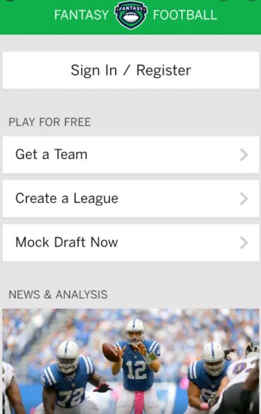
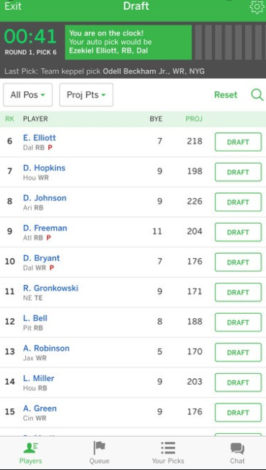
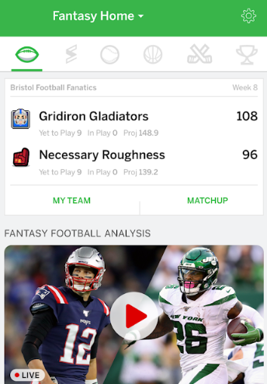
What is EMULADDER?
You know Fantasy Sports, well Welcome to Fantasy eSports!
Create a League
Draft a Team
Review Contest

Slide 3
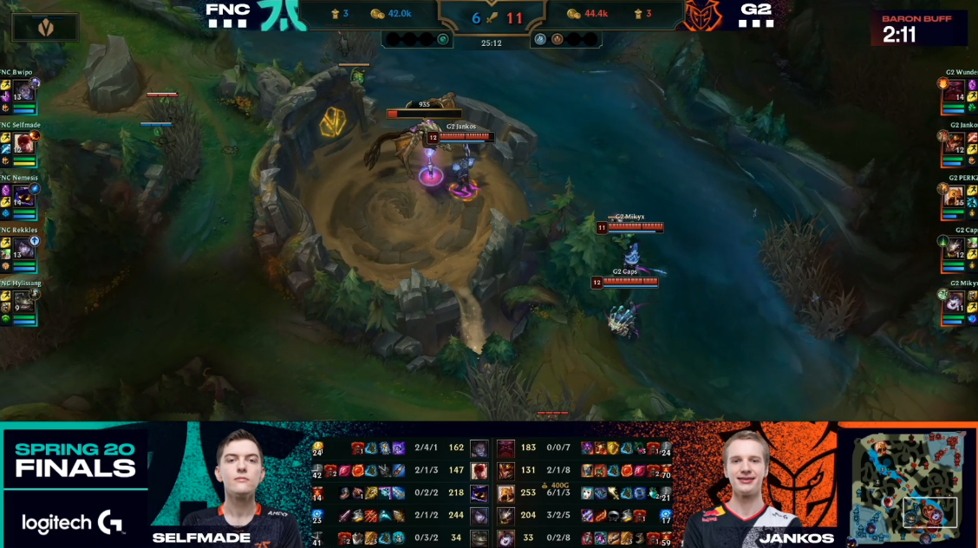
Target Audience
League of Legends World Championship brought in more than 100 million viewers, we look to capitalize on that market.
Tournaments happen on a weekly basis with small breaks between season.
Competition in the space:
DraftKings
FanDuel

Slide 4
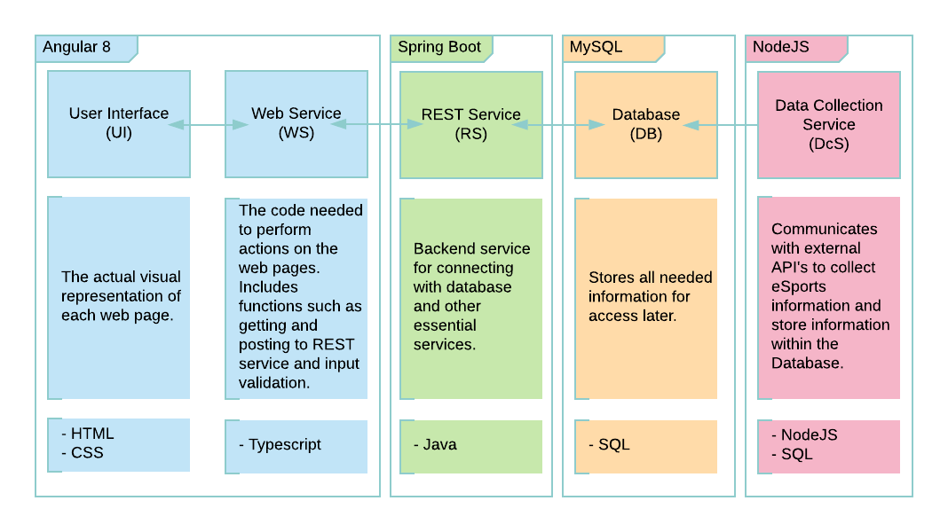





Technologies and Architecture

